Slide 1
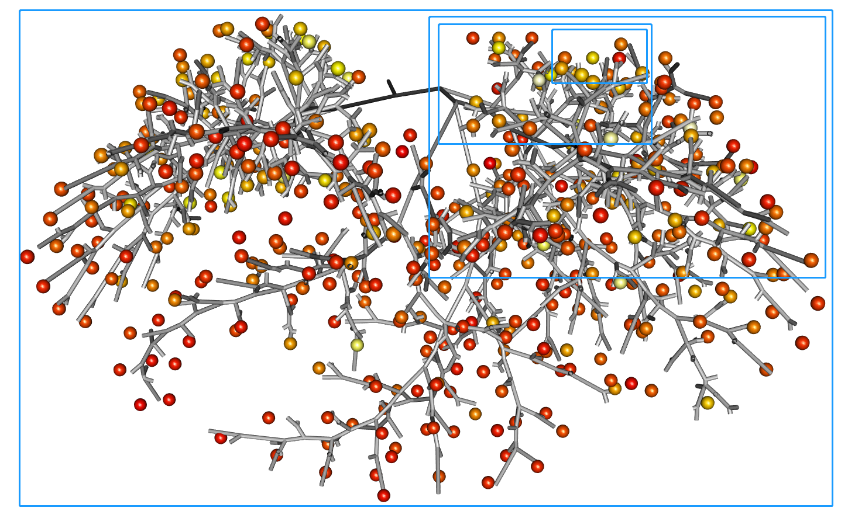
Fractal Analysis of Near-Acini Deposition of LAPDmouse Dataset
Wanjun Gu

Slide 2
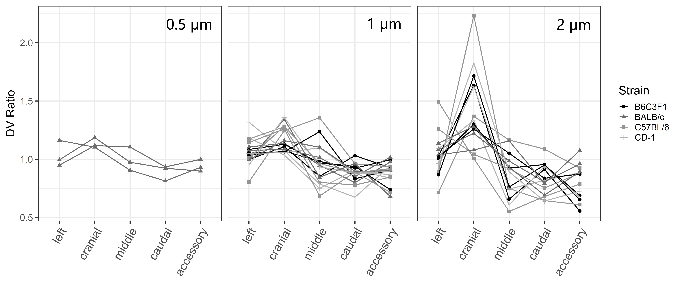

Slide 3
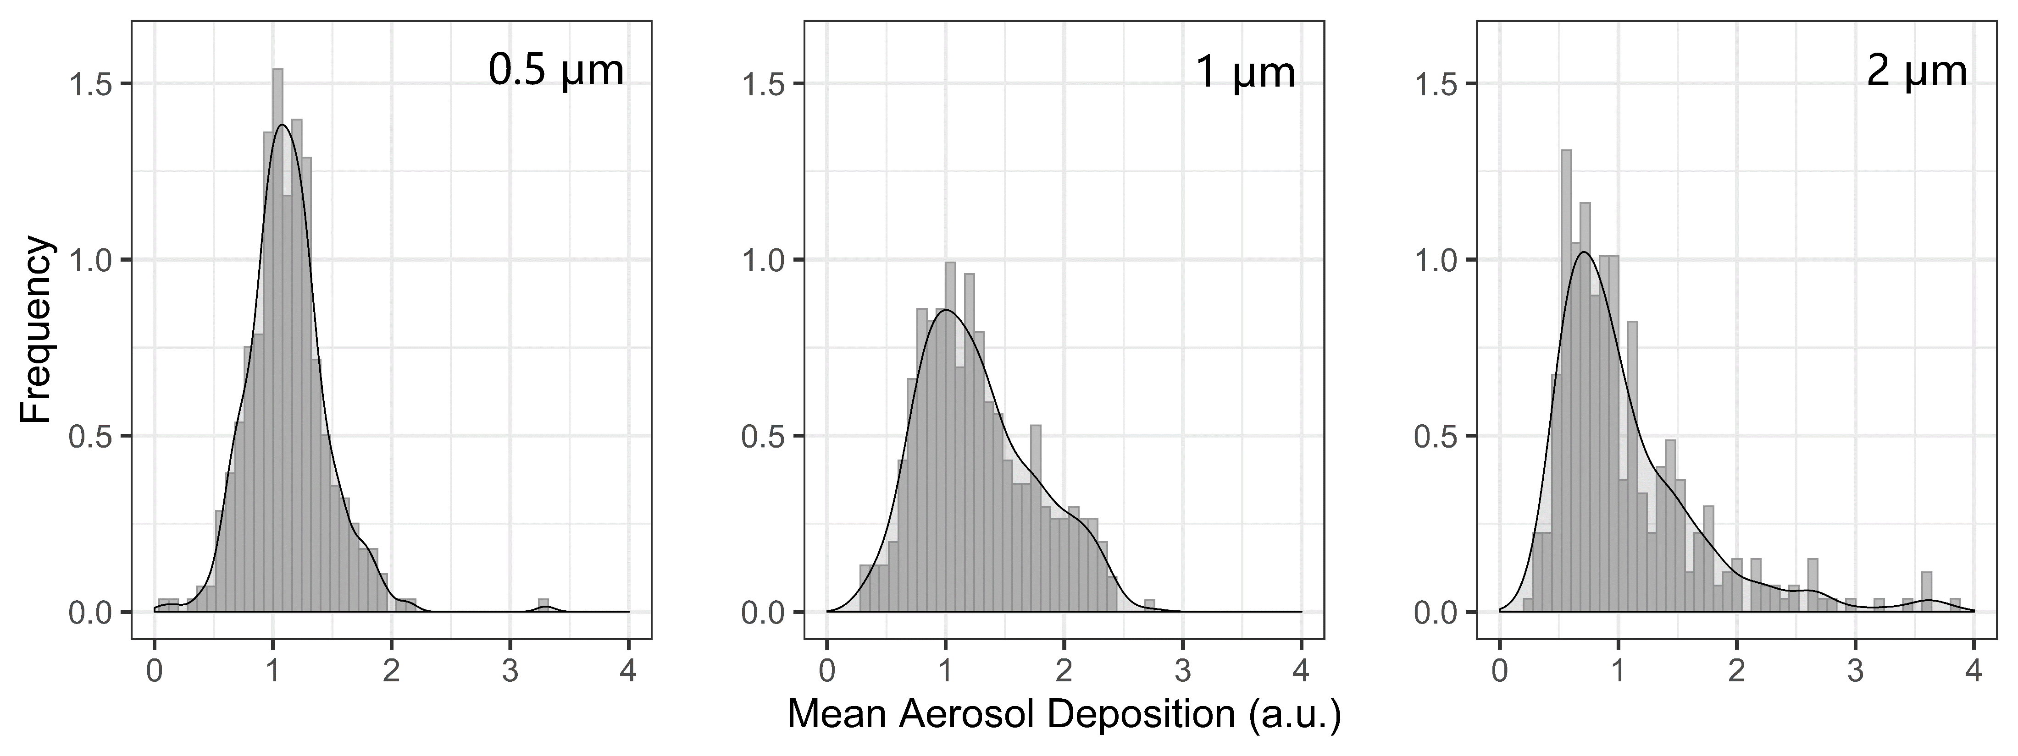

Slide 5
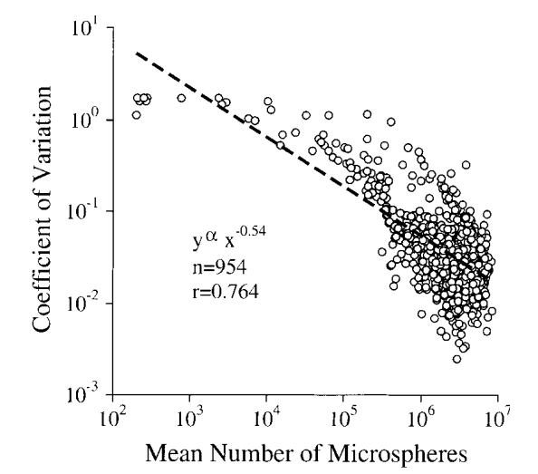
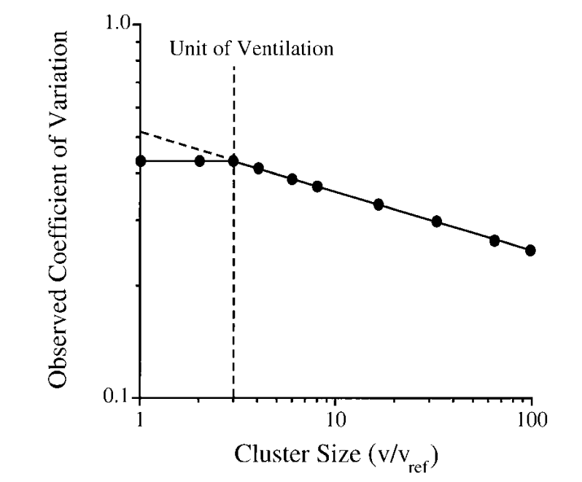
Ref: Altemeier, W. A.; McKinney, S.; Glenny, R. W. Fractal Nature of Regional Ventilation Distribution. J. Appl. Physiol. 2000, 88 (5), 1551–1557.

Slide 6
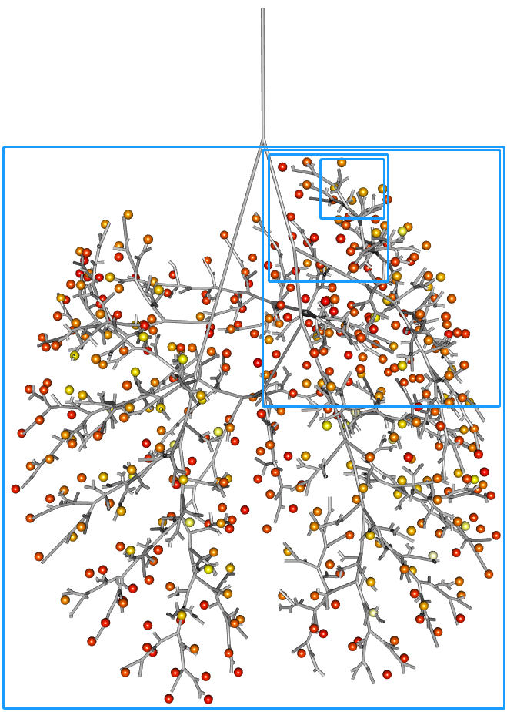
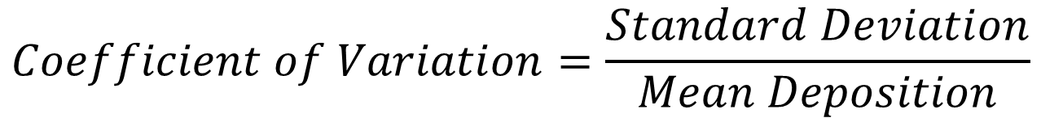
$$Coefficient of Variation=\frac{Standard Deviation}{Mean Deposition}$$

Slide 8
Sample ID | Particle Size | Fractal4 Slope | Fractal5 Slope
m01 | 1 | -0.75898 | -0.72438
m02 | 1 | -0.85835 | -0.72222
m03 | 1 | -0.53219 | -0.58446
m04 | 1 | -0.67389 | -0.65445
m05 | 1 | -0.803 | -0.71499
m06 | 1 | -0.71502 | -0.72518
m07 | 1 | -0.75698 | -0.67578
m08 | 1 | -0.74983 | -0.69062
m09 | 1 | -0.72095 | -0.76329
m10 | 1 | -0.64285 | -0.65515
m11 | 1 | -0.78734 | -0.69809
m12 | 1 | -0.61898 | -0.65996
m13 | 1 | -0.77609 | -0.73032
m14 | 1 | -0.59863 | -0.64185
m15 | 2 | -0.41958 | -0.39218
m16 | 2 | -0.74894 | -0.66949
m17 | 2 | -0.82141 | -0.67408
Sample ID | Particle Size | Fractal4 Slope | Fractal5 Slope
m18 | 2 | -0.54292 | -0.49993
m19 | 2 | -0.59905 | -0.49144
m20 | 2 | -0.53852 | -0.52226
m21 | 2 | -0.54212 | -0.50688
m22 | 2 | -0.72496 | -0.62878
m23 | 2 | -0.67039 | -0.57226
m24 | 2 | -0.70873 | -0.68145
m25 | 2 | -0.7998 | -0.54798
m26 | 2 | -0.54444 | -0.51825
m27 | 2 | -0.5162 | -0.44481
m28 | 2 | -0.69393 | -0.68204
m29 | 2 | -0.65531 | -0.62305
m30 | 1 | -0.61595 | -0.66326
m31 | 1 | -0.77582 | -0.76593
m32 | 0.5 | -0.80122 | -0.72097
m33 | 0.5 | -0.79128 | -0.75776
m34 | 0.5 | -0.72411 | -0.69473

Slide 9
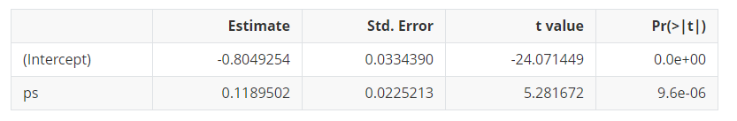

Slide 10
